Slide 1
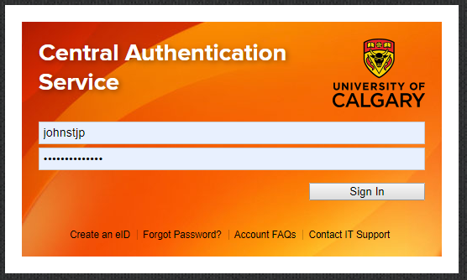
How to access course survey results / Students
Step 1
Login to MyUCalgary with your IT username and password and go to the Student Centre

Slide 2
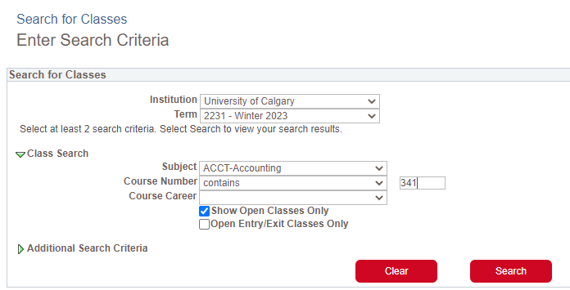
How to access course survey results / Students
Step 2
In your Student Centre, search for classes.

Slide 3
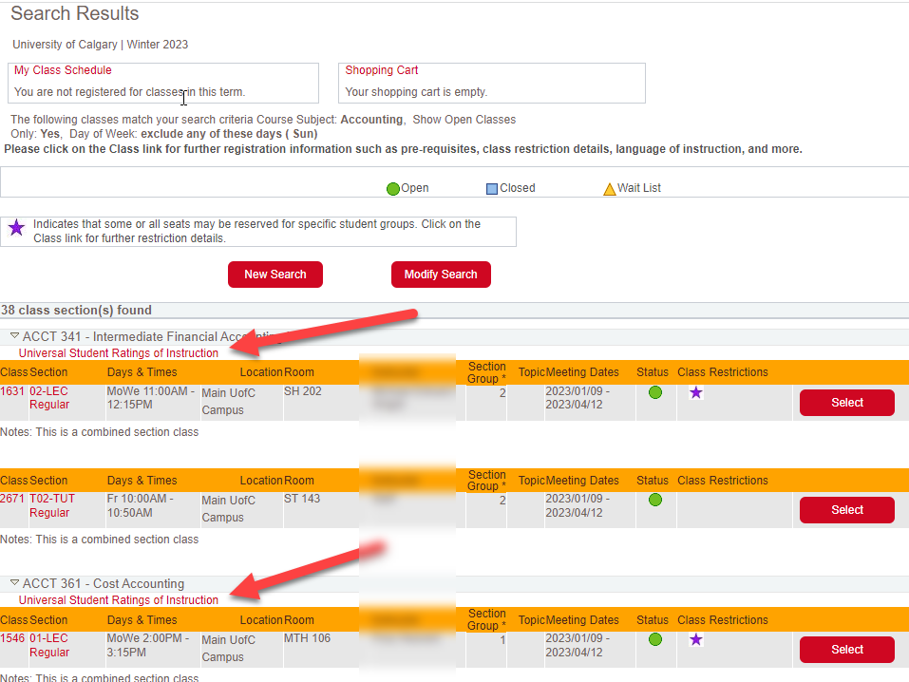
How to access course survey results / Students
Step 3
The search results will list classes and each will have a link to past course survey results.

Slide 4
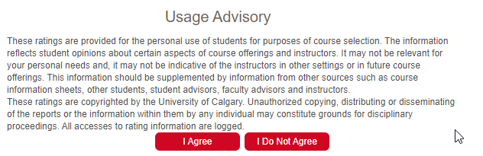
How to access course survey results / Students
Step 4
Agree to the Usage Advisory

Slide 5
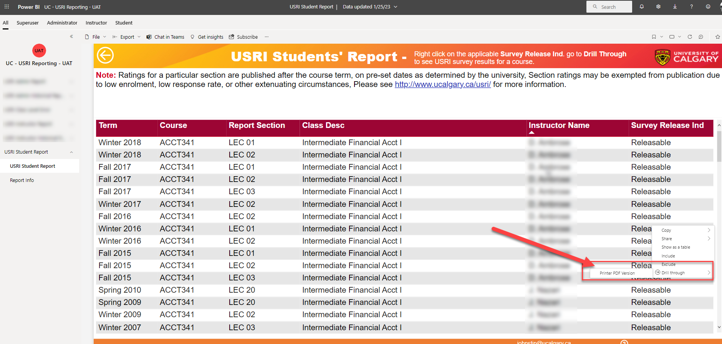
How to access course survey results / Students
Step 5
Right-click on “Releasable” beside the course you want to see
Go to “Drill Through”
Select “Printer PDF Version”

Slide 6
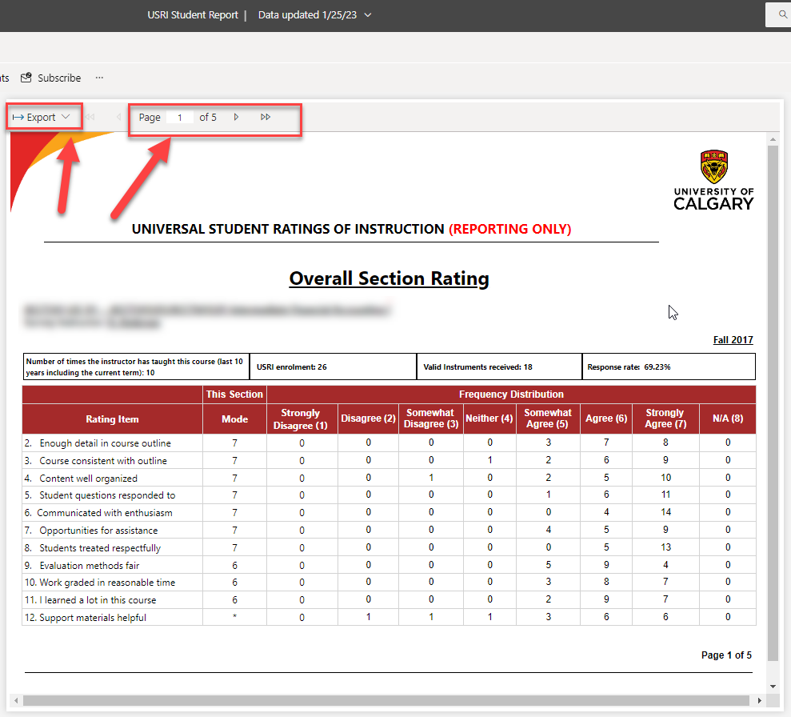
Viewing Reports / Students
How to view results
The Printer PDF version gives you the option to navigate through 5 web pages

Slide 7
Support
Questions?
coursesurvey@ucalgary.ca
Student Resources & FAQs

