Slide 1
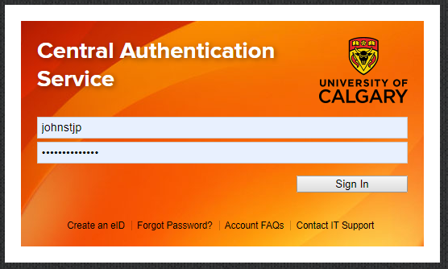
How to access PowerBI Course Survey Reports/ Administrators
Step 1
Login here with your IT username and password

Slide 2
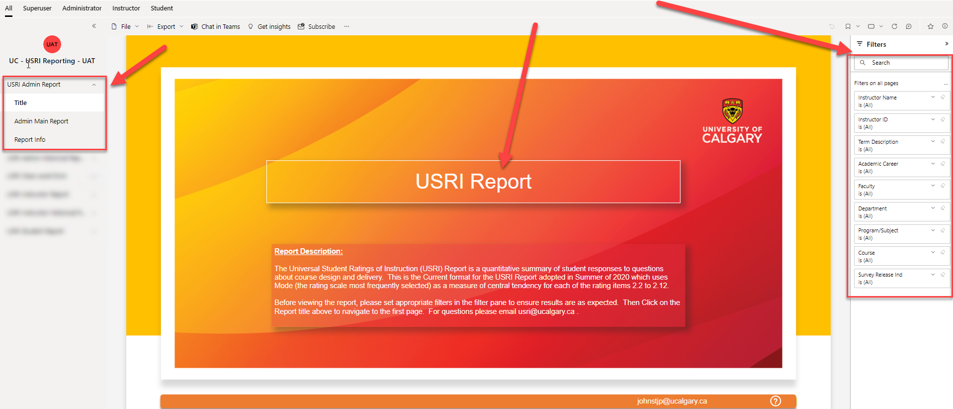
How to access PowerBI Course Survey Reports/ Administrators
Step 2
Using the navigation options on the left column, go to the “Title” page.
Using the filters on the right, select the parameters of what you want to see reports for (i.e. Term, Instructor Name, etc.…)
Then click on the USRI Report button in the middle of the screen.
You can clear and reset the filters with the back arrow button above the filters and to the left.

Slide 3
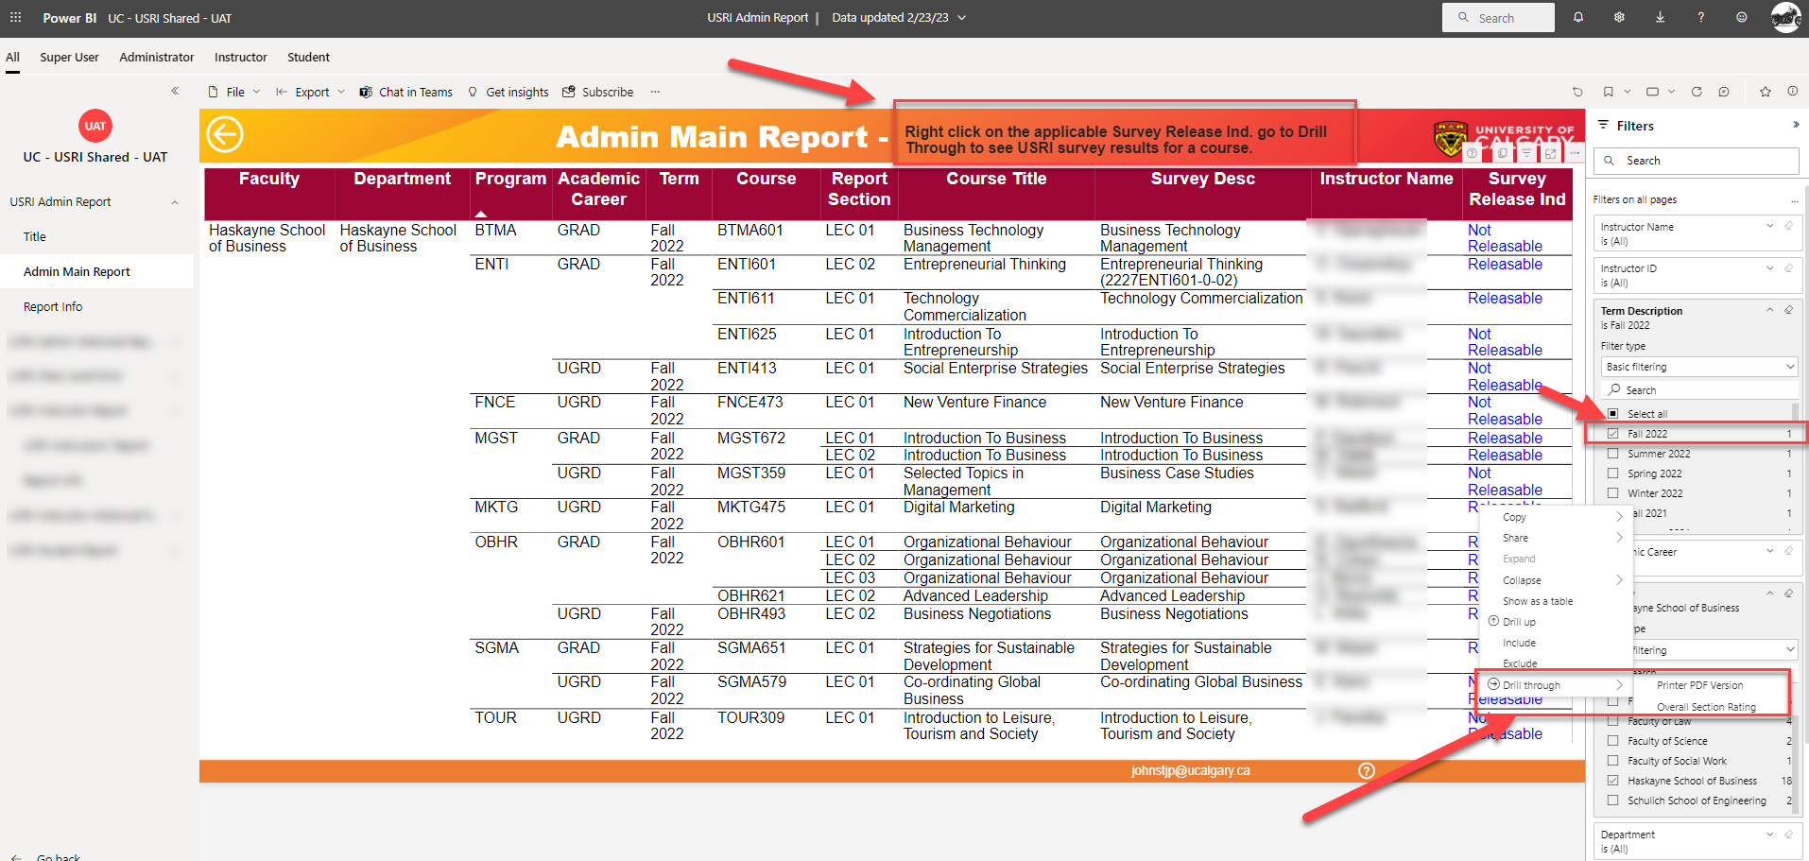

How to access PowerBI Course Survey Reports/ Administrators
Step 3
Find the row for the course & section # you want, in that row right click on the “Survey Release Indicator” and then go to “Drill Through” and select “Overall Section Rating” or “Printer PDF Version”

Slide 4
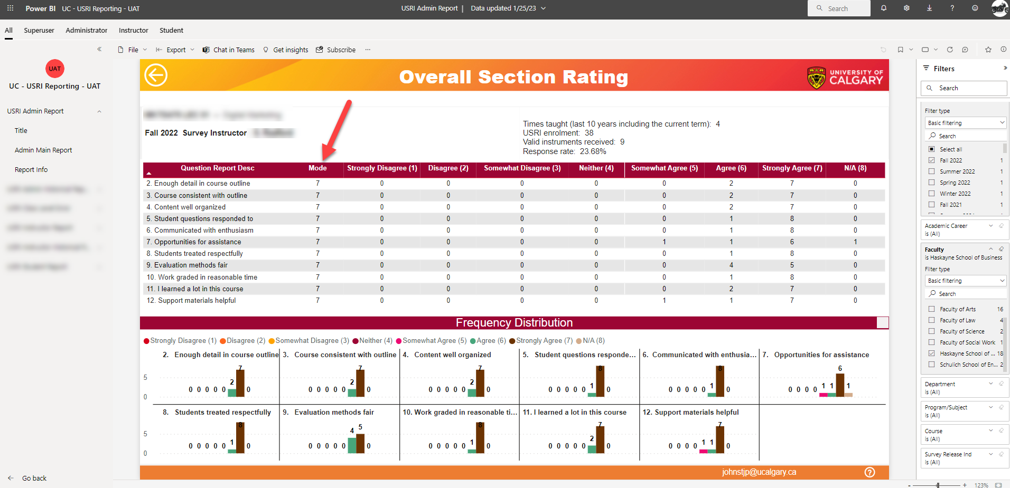
How to access PowerBI Course Survey Reports/ Administrators
How to see results
The Overall Section Rating screen contains a table and a chart illustration of the mode (most frequently selected rating point) for each of the 11 USRI questions and their distribution breakdown.
If two or more rating points are equal then an asterisk will be displayed for mode (*).

Slide 5
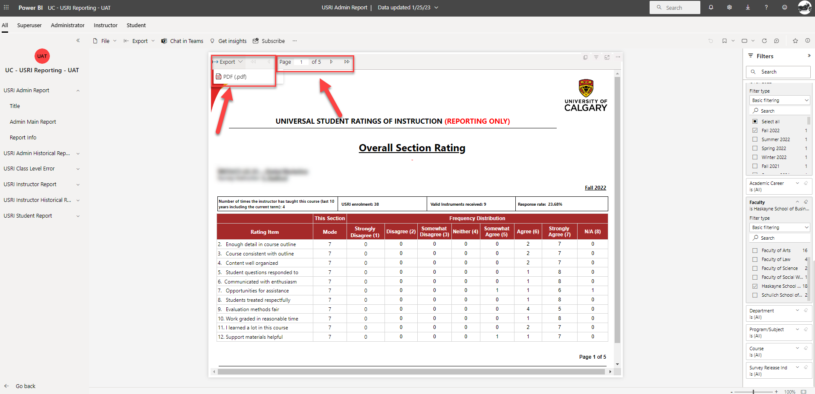
How to access PowerBI Course Survey Reports/ Administrators
How to see results
The Printer PDF version gives you the option to navigate through 5 web pages and includes demographic data and an interpretation guide providing context and additional information
You can export to PDF and save the file to your computer

Slide 6
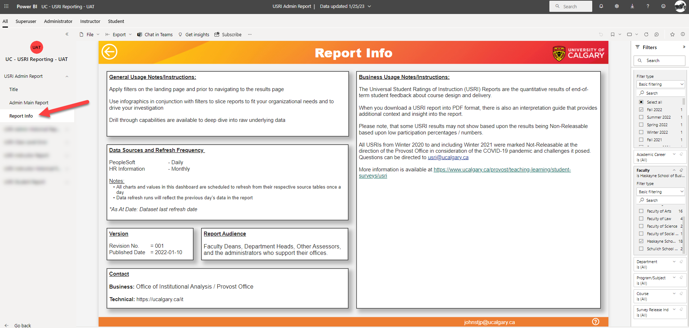
Administrators and USRIs
How to see results
Use the navigation options on the left column to go to Report Info
This provides information about the report

Slide 7
Support
Questions?
coursesurvey@ucalgary.ca
Administrator Resources & FAQs web link

